Slide 1
Network-Attack-Resilient Intrusion-Tolerant SCADA for the Power Grid
Amy Babay, Thomas Tantillo, Trevor Aron,
Marco Platania, and Yair Amir
Johns Hopkins University, AT&T Labs, Spread Concepts LLC

Slide 2



Importance of SCADA Systems
Supervisory Control and Data Acquisition (SCADA) systems form the backbone of critical infrastructure services
Power grid, water supply, waste management
To preserve control and monitoring capabilities, SCADA systems must be constantly available and run at their expected level of performance (able to react within 100-200ms)
SCADA system failures and downtime can cause catastrophic consequences, such as equipment damage, blackouts, and human casualties

Slide 3
Basic SCADA Architecture
Remote Terminal Units (RTUs) and Programmable Logic Controllers (PLCs): Control physical equipment in power substations
SCADA Master: Central control server, maintains current state of the system (based on updates from RTUs/PLCs) and issues supervisory commands
Human Machine Interface (HMI): provide graphical displays for operators to interact with the system
Control Center
LAN
HMI
SCADA Master
Wide-Area Network
RTU
PLC
…
Physical
Equipment
Physical
Equipment
Substation
Substation

Slide 4
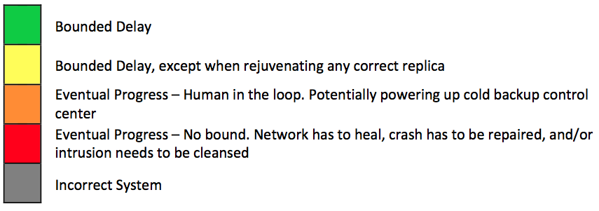
Basic SCADA Architecture
1
Control Center
LAN
HMI
SCADA Master
For illustration only – this is a very fragile architecture
Wide-Area Network
RTU
PLC
…
Physical
Equipment
Physical
Equipment
Substation
Substation

Slide 5
Modern SCADA Systems
2-2
Primary Control Center
Cold-Backup Control Center
LAN
LAN
HMI
SCADA Master Primary
SCADA Master Hot Standby
HMI
SCADA Master Primary
SCADA Master Hot Standby
Modern systems add fault-tolerance
Wide-Area Network
RTU
PLC
…
Physical
Equipment
Physical
Equipment
Substation
Substation

Slide 6
Modern SCADA Systems
2-2
Primary Control Center
Cold-Backup Control Center
LAN
LAN
HMI
SCADA Master Primary
SCADA Master Hot Standby
HMI
SCADA Master Primary
SCADA Master Hot Standby
Modern systems add fault-tolerance…but is it enough?
Wide-Area Network
RTU
PLC
…
Physical
Equipment
Physical
Equipment
Substation
Substation

Slide 7
Hostile Operating Environments
Traditional SCADA systems ran on proprietary networks
Created air gap from outside world and attackers
Cost benefits and ubiquity of IP networks are driving SCADA to use IP networks
Exposes SCADA to hostile environments, removing the air gap
Raises additional concerns because SCADA systems are:
In service for decades
Running legacy code with well-known exploits
Increasingly becoming a target for attackers
Attacks: Stuxnet (2010), Ukraine (2015, 2016), and others…

Slide 8
Hostile Environments
Fault tolerance is no longer sufficient
System-level attacks
Compromised SCADA master can issue malicious control commands and manipulate monitoring information
Hot-backup is not effective: compromised primary reports that it is working correctly
Network-level attacks
Sophisticated attacks can take the primary control center offline at the time of the attacker’s choosing
Cold-backup inherently incurs downtime (on the order of hours). Not effective when the attacker controls when downtime occurs and can force it to occur repeatedly
Hot-backup introduces inconsistency due to “split-brain” problem

Slide 9
Modern SCADA Systems
2-2
Primary Control Center
Cold-Backup Control Center
LAN
LAN
HMI
SCADA Master Primary
SCADA Master Hot Standby
HMI
SCADA Master Primary
SCADA Master Hot Standby
Fault tolerance is not sufficient in hostile environments
Wide-Area Network
RTU
PLC
…
Physical
Equipment
Physical
Equipment
Substation
Substation

Slide 10
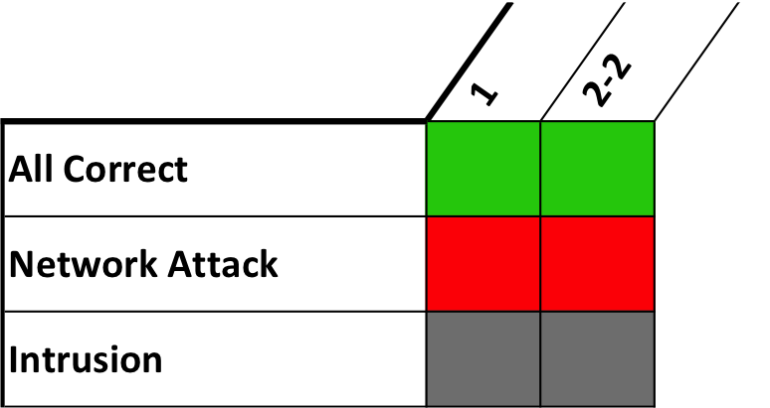
Modern SCADA Systems
2-2
Primary Control Center
Cold-Backup Control Center
LAN
LAN
HMI
SCADA Master Primary
SCADA Master Hot Standby
HMI
SCADA Master Primary
SCADA Master Hot Standby
Fault tolerance is not sufficient in hostile environments
Wide-Area Network
RTU
PLC
…
Physical
Equipment
Physical
Equipment
Substation
Substation

Slide 11
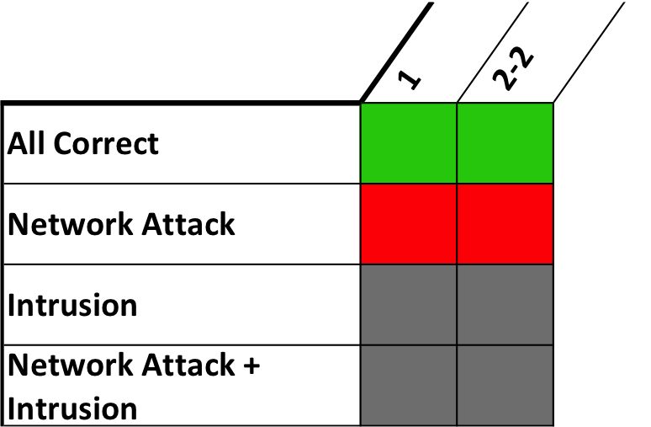
Modern SCADA Systems
2-2
Primary Control Center
Cold-Backup Control Center
LAN
LAN
HMI
SCADA Master Primary
SCADA Master Hot Standby
HMI
SCADA Master Primary
SCADA Master Hot Standby
Fault tolerance is not sufficient in hostile environments
Wide-Area Network
RTU
PLC
…
Physical
Equipment
Physical
Equipment
Substation
Substation

Slide 12
Our Contribution
The first SCADA architecture that simultaneously addresses system (SCADA master) compromises and network attacks
Key idea: distributes SCADA master replicas across three or more active geographic sites to ensure continuous availability
An extension of the architecture that avoids constructing additional power company control centers by leveraging commodity data centers
Makes the architecture feasible for deployment
An open-source implementation and evaluation of the architecture
Spire: www.dsn.jhu.edu/spire

Slide 13
Addressing System Compromises
Byzantine Fault Tolerant Replication (BFT)
Correctly maintains state in the presence of compromises
3f+1 replicas needed to tolerate up to f intrusions
2f+1 connected correct replicas required to make progress
Prime protocol – latency guarantees under attack [ACKL11]
Notes:
Amir, Y. and Coan, B. and Kirsch, J. and Lane, J.
IEEE Transactions on Dependable and Secure Computing (TDSC), 8(4), pages 564-577, July 2011.

Slide 14
Addressing System Compromises
Byzantine Fault Tolerant Replication (BFT)
Correctly maintains state in the presence of compromises
3f+1 replicas needed to tolerate up to f intrusions
2f+1 connected correct replicas required to make progress
Prime protocol – latency guarantees under attack [ACKL11]
What prevents an attacker from reusing the same exploit to compromise more than f replicas?

Slide 15
Addressing System Compromises
Byzantine Fault Tolerant Replication (BFT)
Correctly maintains state in the presence of compromises
3f+1 replicas needed to tolerate up to f intrusions
2f+1 connected correct replicas required to make progress
Prime protocol – latency guarantees under attack [ACKL11]
Diversity
Present a different attack surface so that an adversary cannot exploit a single vulnerability to compromise all replicas
Multicompiler from UC Irvine [HNLBF13]
Notes:
Homescu, A. and Neisius, S. and Larsen, P. and Brunthaler, S. and Franz, M.
IEEE/ACM Int. Symp. Code Generation and Optimization (CGO) 2013
Profile-guided automated software diversity

Slide 16
Addressing System Compromises
Byzantine Fault Tolerant Replication (BFT)
Correctly maintains state in the presence of compromises
3f+1 replicas needed to tolerate up to f intrusions
2f+1 connected correct replicas required to make progress
Prime protocol – latency guarantees under attack [ACKL11]
Diversity
Present a different attack surface so that an adversary cannot exploit a single vulnerability to compromise all replicas
Multicompiler from UC Irvine [HNLBF13]
What prevents an attacker from compromising more than f replicas over time?

Slide 17
Addressing System Compromises
Byzantine Fault Tolerant Replication (BFT)
Correctly maintains state in the presence of compromises
3f+1 replicas needed to tolerate up to f intrusions
2f+1 connected correct replicas required to make progress
Prime protocol – latency guarantees under attack [ACKL11]
Diversity
Present a different attack surface so that an adversary cannot exploit a single vulnerability to compromise all replicas
Multicompiler from UC Irvine [HNLBF13]
Proactive Recovery
Periodically rejuvenate replicas to a known good state to cleanse any potentially undetected intrusions
3f+2k+1 replicas needed to simultaneously tolerate up to f intrusions and k recovering replicas [SBCNV10]
2f+k+1 connected correct replicas required to make progress
Notes:
P. Sousa, A. Bessani, M. Correia, N. F. Neves, and P. Verissimo, “Highly
available intrusion-tolerant services with proactive-reactive recovery,”
IEEE Trans. Parallel Distrib. Syst., vol. 21, no. 4, pp. 452–465, 2010.

Slide 18
Intrusion Tolerance State-of-the-Art in Research
6
(progress: 4)
A Single Control Center
LAN
HMI
SCADA
Master
SCADA
Master
SCADA
Master
SCADA
Master
SCADA
Master
SCADA
Master
3f+2k+1 = 6 total replicas
2f+k+1 = 4 connected correct replicas required to provide bounded delay
Wide-Area Network
RTU
PLC
…
Physical
Equipment
Physical
Equipment
Substation
Substation

Slide 19
Addressing Network Attacks (Part 1): Spines Intrusion-Tolerant Network
NYC
CHI
SJC
DEN
JHU
WAS
SVG
LAX
ATL
DFW
[IEEE ICDCS 2016]
Resilient Overlay Network Architecture: overcomes compromises in the underlying network infrastructure
Intrusion-Tolerant Overlay Protocols: overcome compromises of overlay nodes

Slide 20
Addressing Network Attacks (Part 1): Spines Intrusion-Tolerant Network
Makes widespread network disruption nearly infeasible (requires simultaneous meltdown of multiple ISP backbones)
A dedicated (e.g. nation-state) attacker can still invest the resources to disconnect a single targeted site
Reduces the problem of addressing arbitrary network attacks to handling a single downed or disconnected site

Slide 21
New Natural Extensions (1/2): Primary-Backup Sites with Intrusion-Tolerant Replication
6-6
Primary Control Center
Cold-Backup Control Center
LAN
LAN
HMI
SM
SM
SM
SM
SM
SM
HMI
SM
SM
SM
SM
SM
SM
Spines Intrusion-Tolerant Network
RTU
PLC
…
Physical
Equipment
Physical
Equipment
Substation
Substation

Slide 22
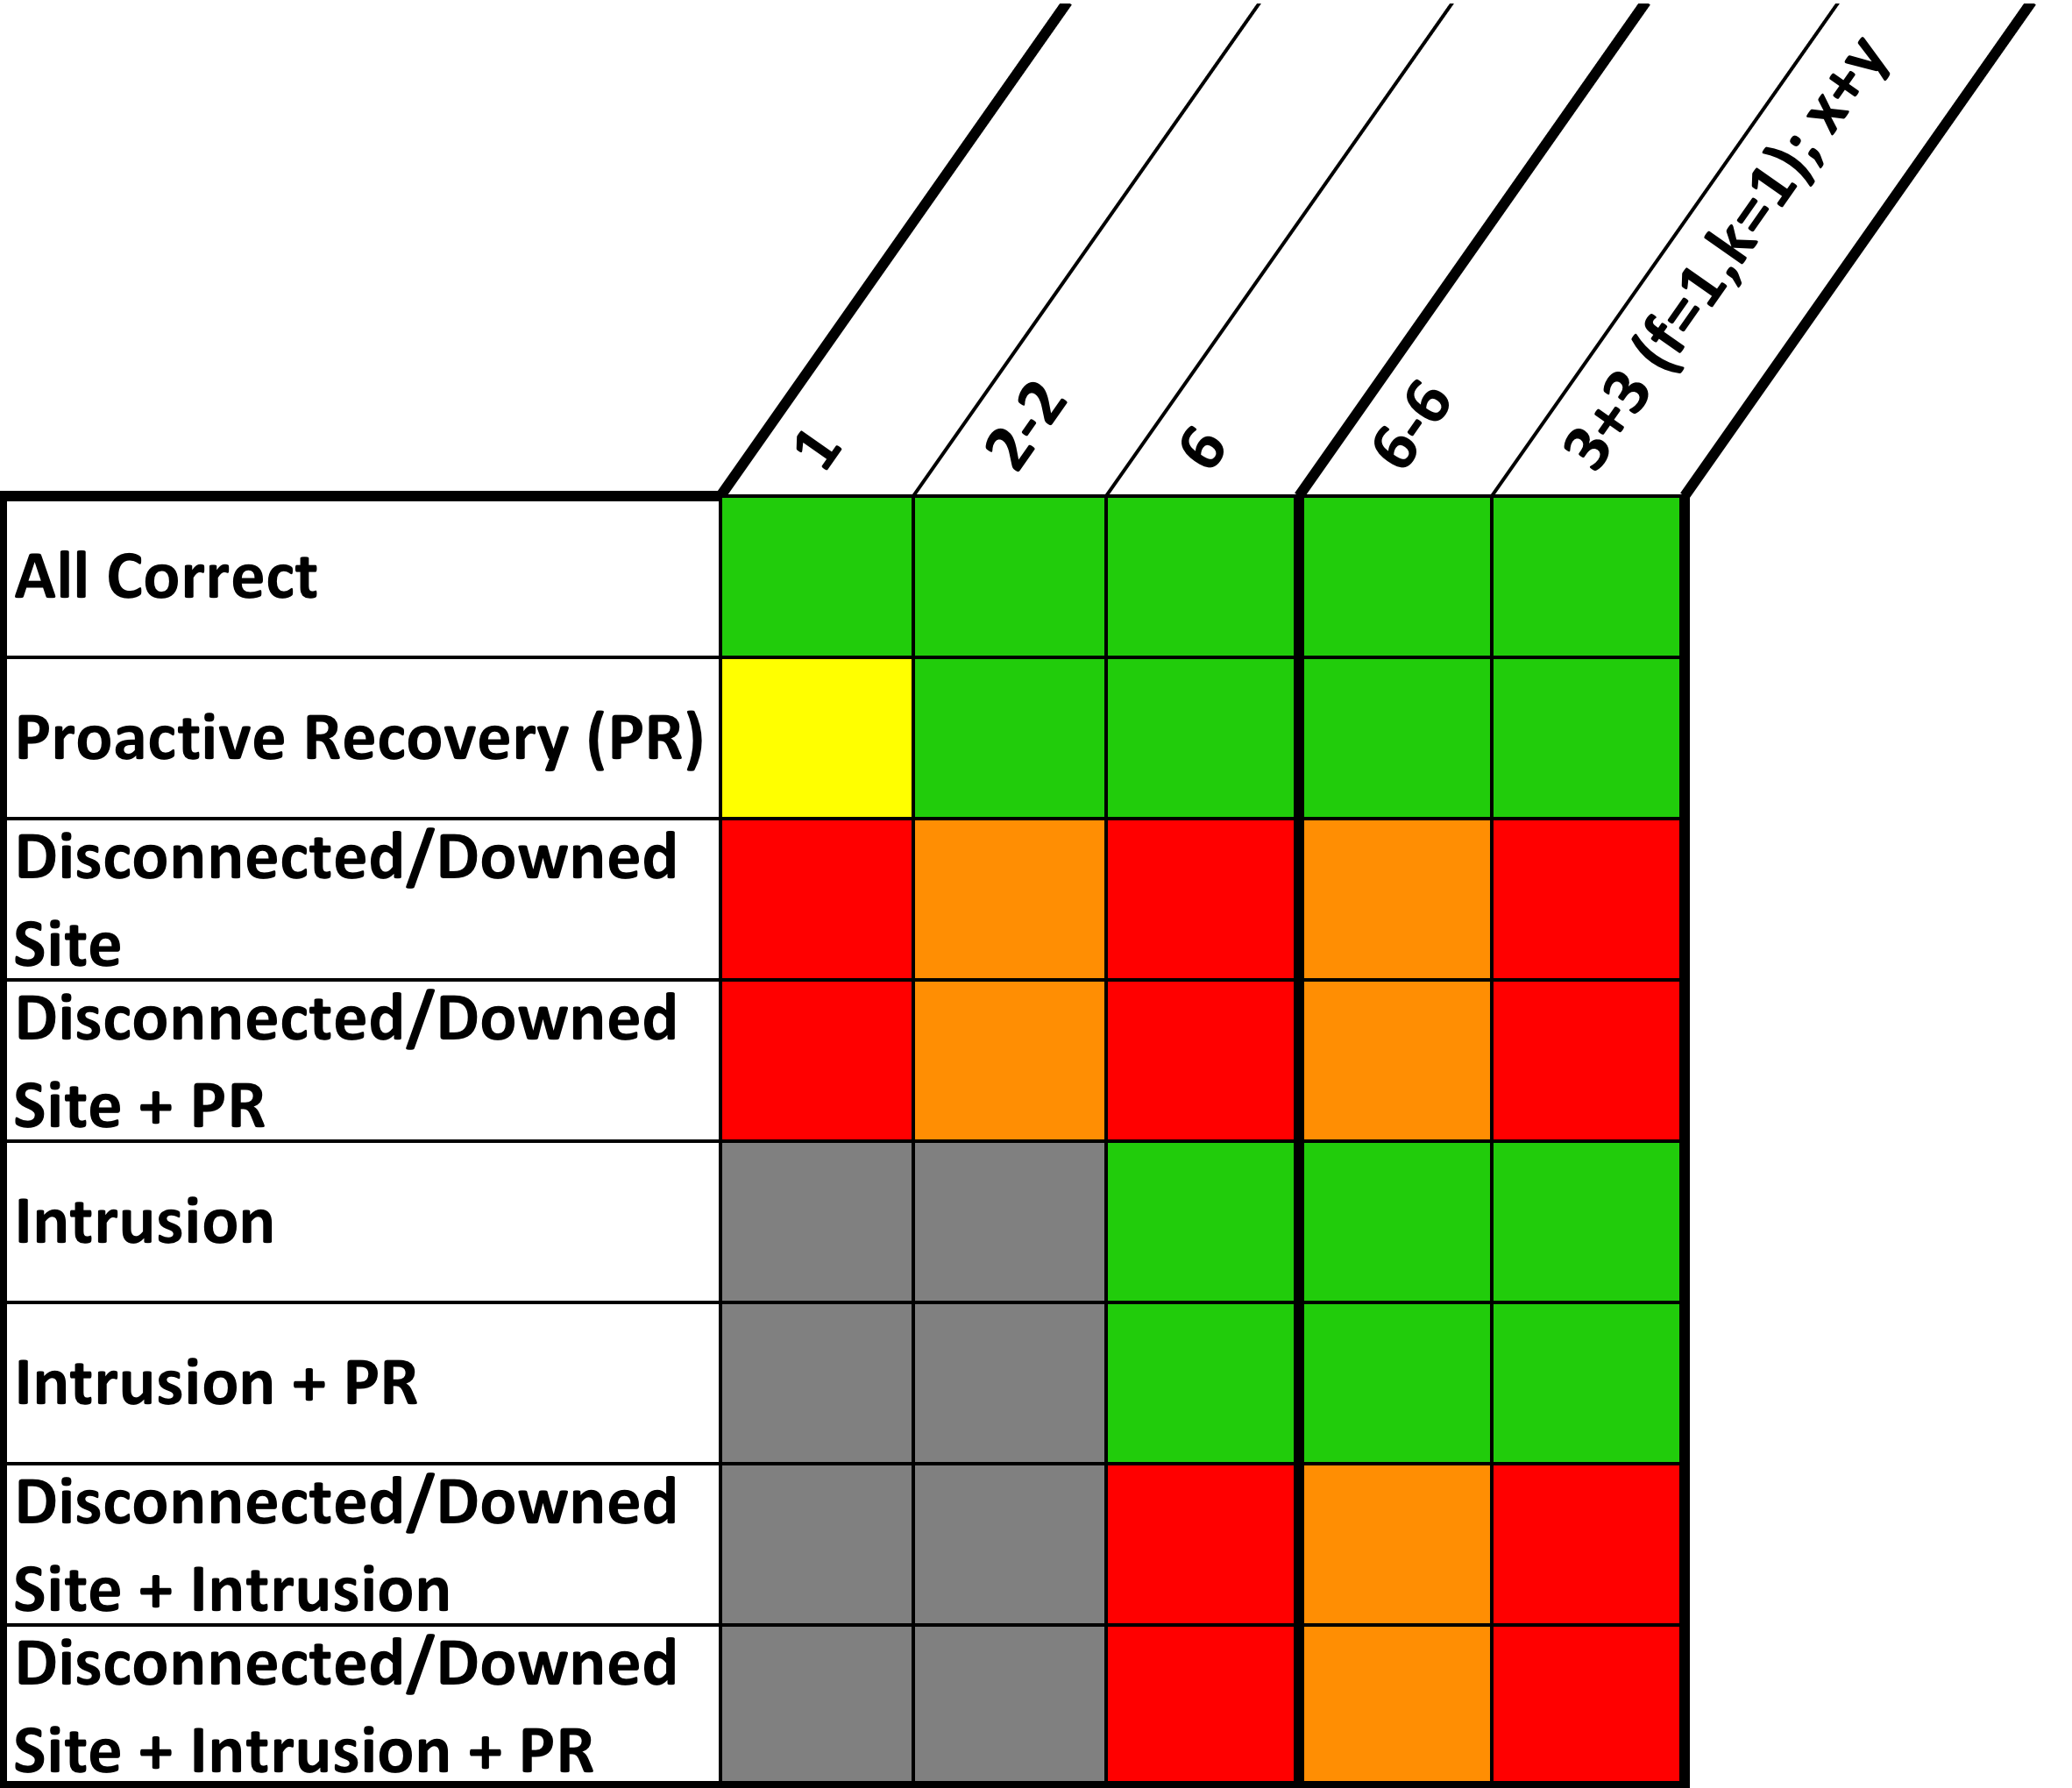
New Natural Extensions (2/2): Active Intrusion-Tolerant Replication across Two Sites
3+3
(progress: 4)
Control Center 1
Control Center 2
LAN
LAN
HMI
SM
SM
SM
HMI
SM
SM
SM
Need more than two sites to provide continuous availability!
Spines Intrusion-Tolerant Network
RTU
PLC
…
Physical
Equipment
Physical
Equipment
Substation
Substation

Slide 23
Addressing Network Attacks (Part 2): Active Replication Across Three or More Sites
Two sites (even if both active) cannot provide intrusion tolerance and the necessary resilience to network attacks
True for any X + Y configuration
Replication protocol requires more than half the replicas to work
Site disconnection can make at least half of the system unavailable
Therefore, a solution requires active replication across three or more sites
Control centers are expensive!
Setup to control, monitor, and communicate with RTUs in the field
Therefore, to be feasible, solutions should fit the two-control center model used by power companies
New idea: devise an architecture where additional sites beyond the two control centers do not need to control RTUs or PLCs
Commodity data centers provide cost-effective alternative
Commodity data centers are becoming prevalent

Slide 24
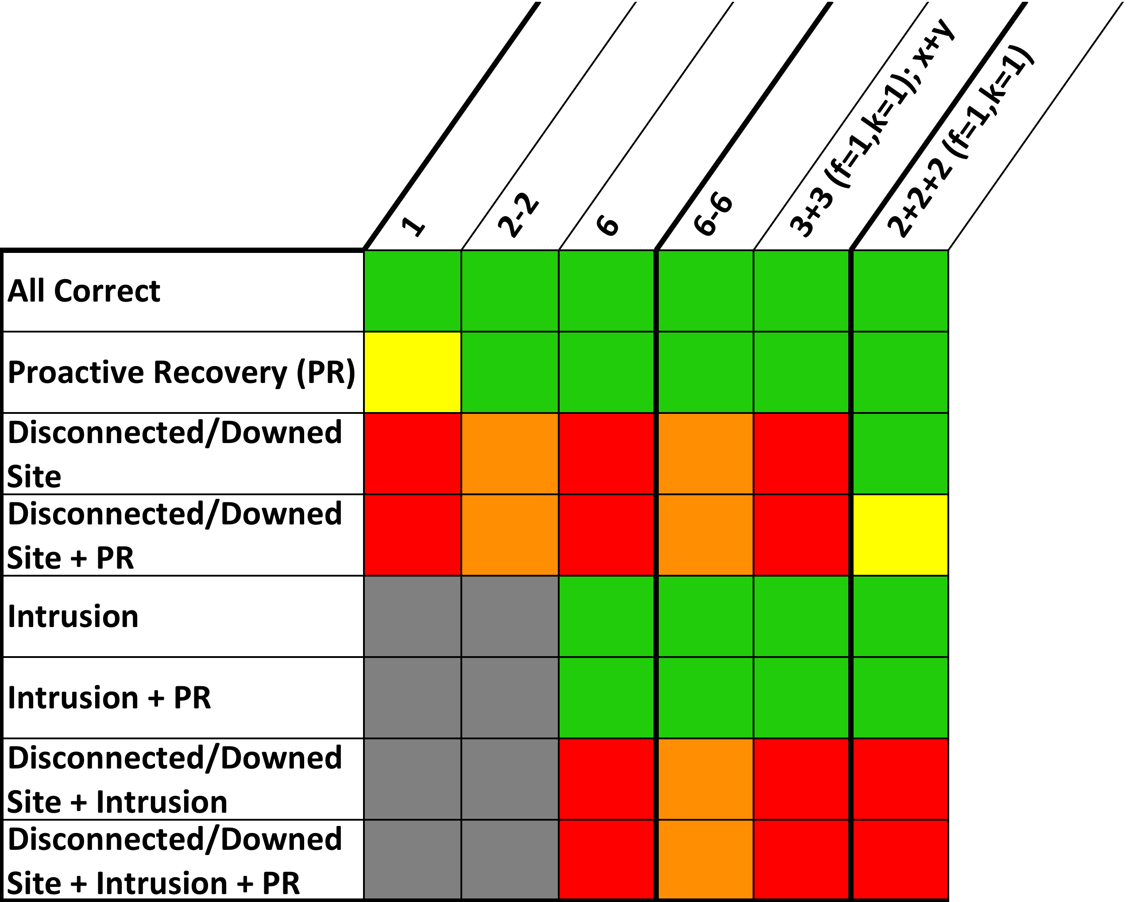
Novel Resilient Configurations (1/6)
2+2+2
(progress: 4)
Data Center 1
Two separate Spines networks:
One to communicate with RTUs in the field
One for SCADA Master coordination
SM
SM
Control Center 1
Spines
Control Center 2
HMI
SM
SM
SM
SM
HMI
Need to increase the number of replicas to cover disconnected sites due to network attacks!
Spines
RTU
PLC
…
Physical
Equipment
Physical
Equipment
Substation
Substation

Slide 25
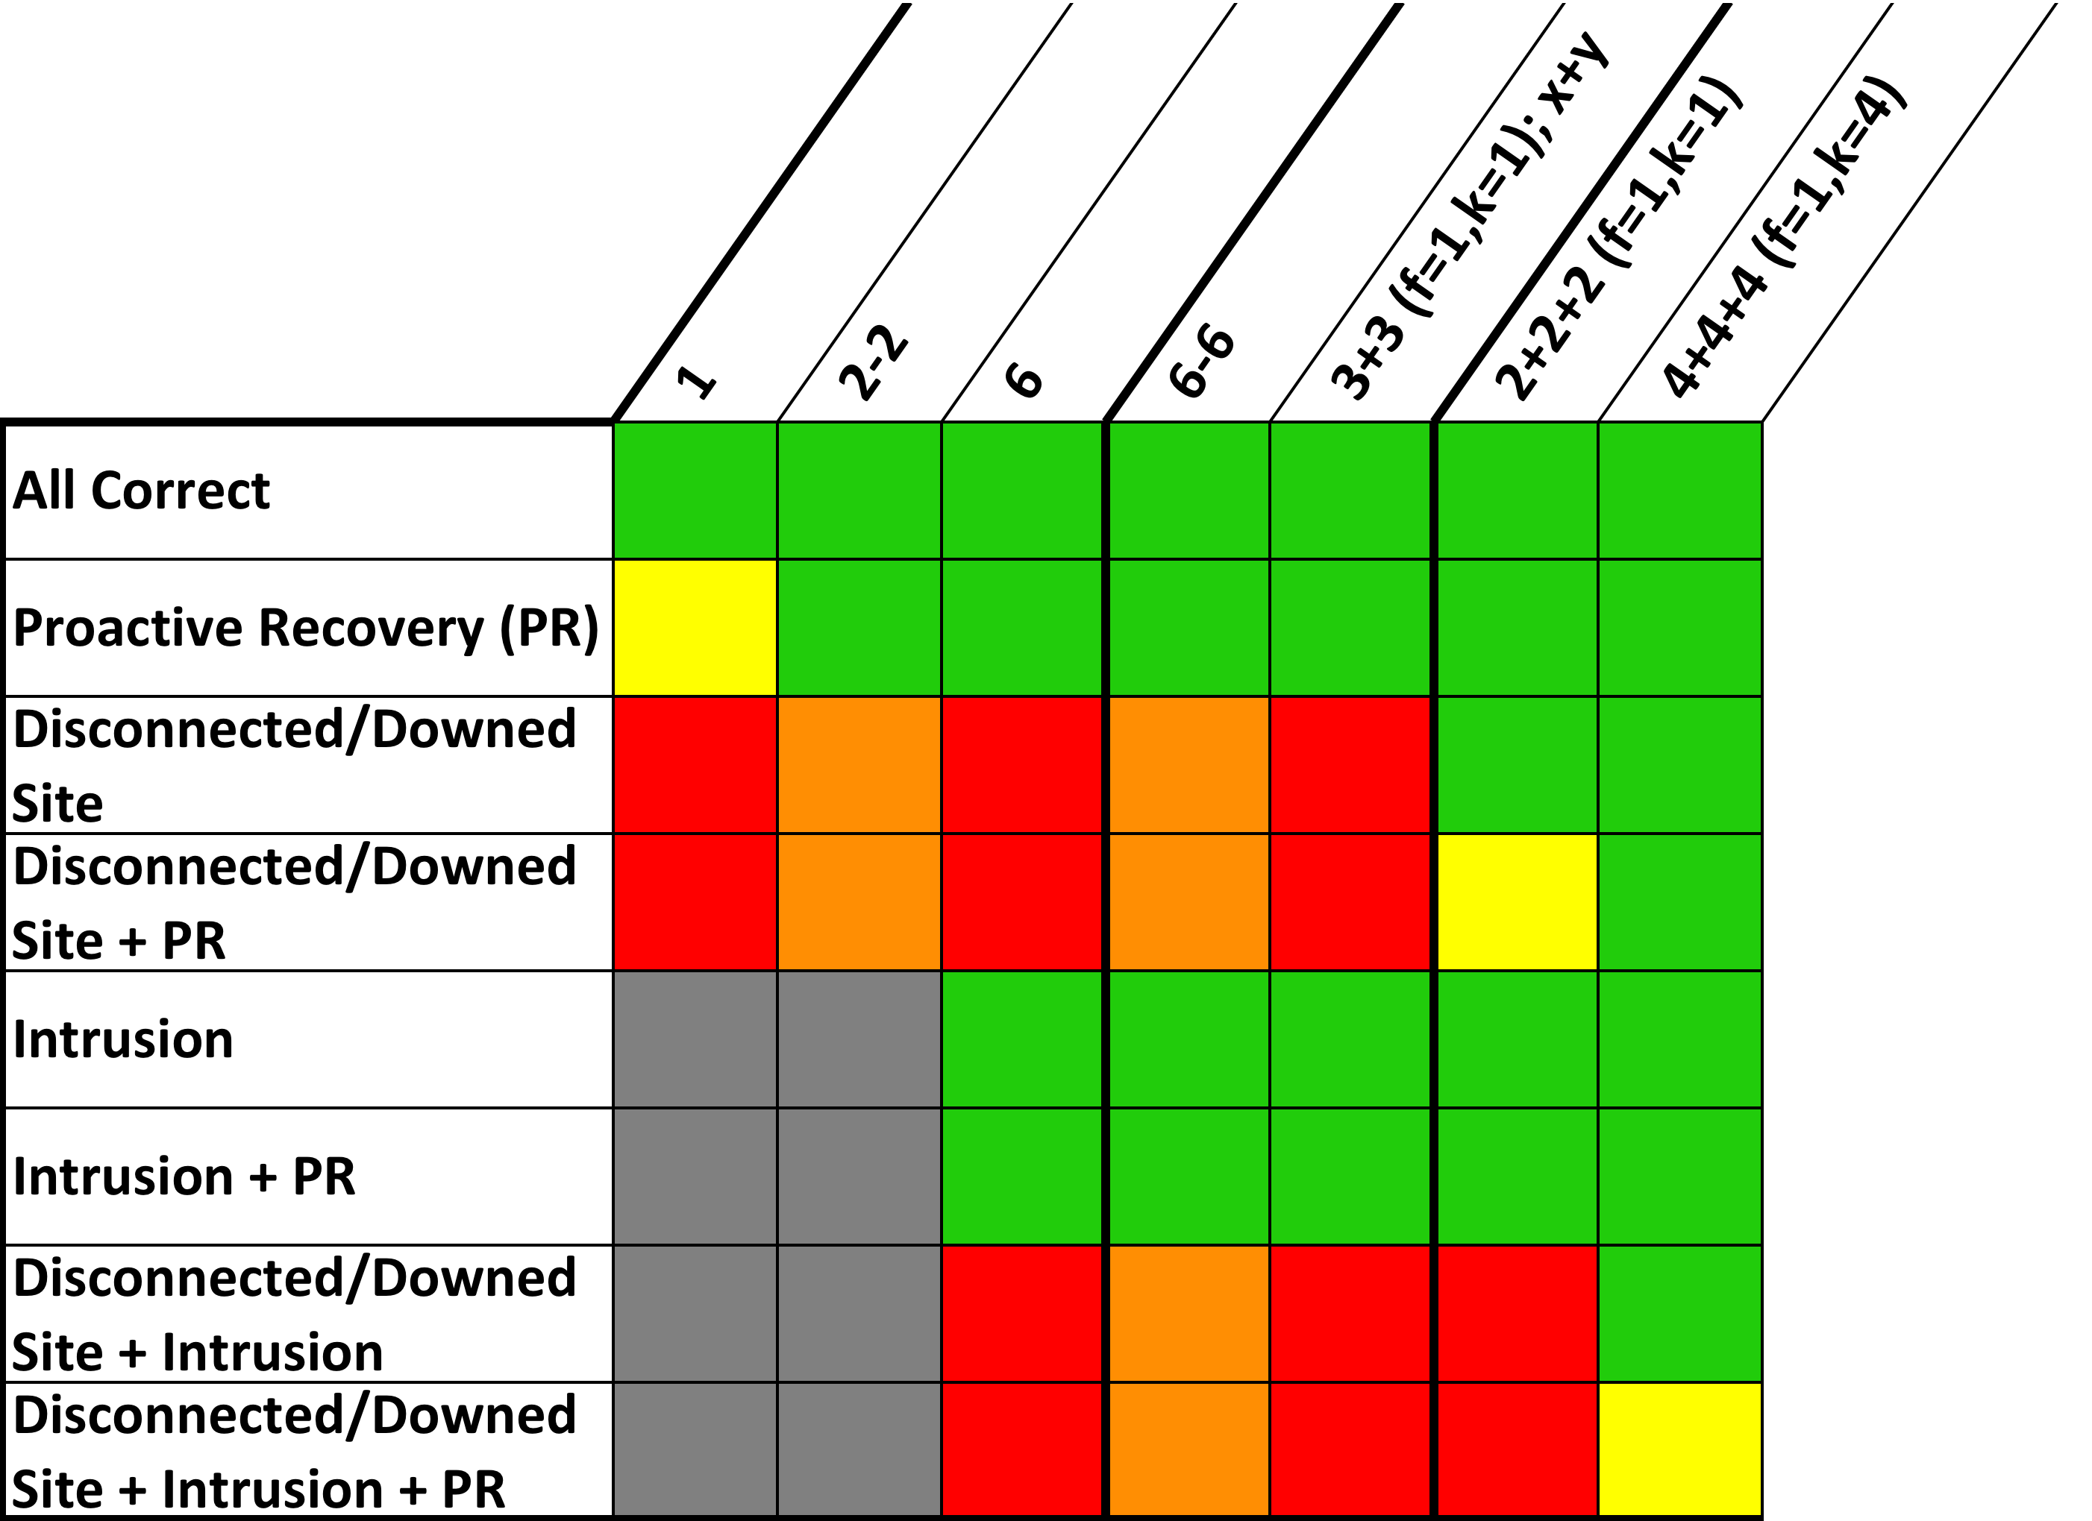
Novel Resilient Configurations (2/6)
4+4+4
(progress: 7)
Data Center 1
SM
SM
SM
SM
Control Center 1
Spines
Control Center 2
Increase k to include the number of replicas in the largest site. In this case, k = 4.
HMI
SM
SM
SM
SM
SM
SM
SM
SM
HMI
Spines
3f+2k+1 = 3(1)+2(4)+1 = 12
RTU
PLC
…
Physical
Equipment
Physical
Equipment
Substation
Substation

Slide 26
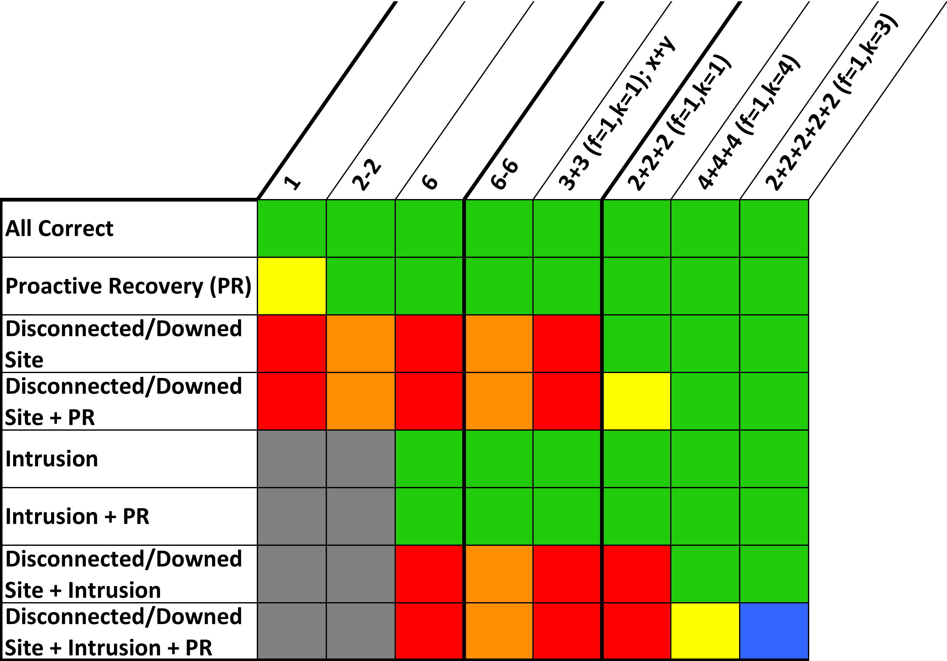
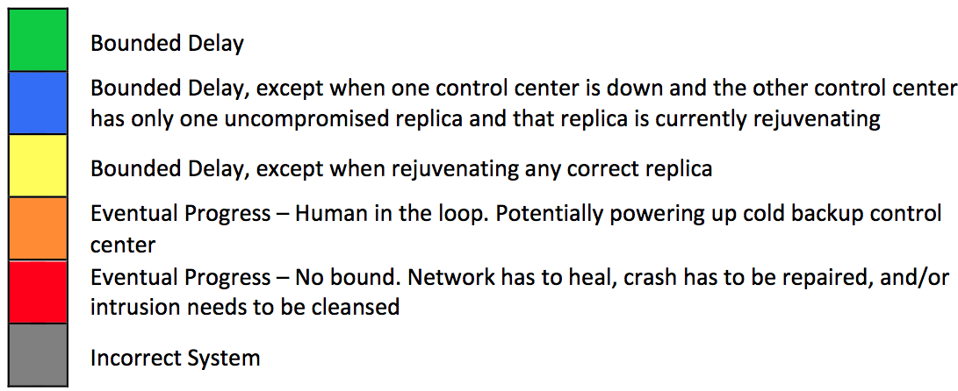
Novel Resilient Configurations (3/6)
2+2+2+2+2
(2 control centers)
(progress: 6)
Data Center 1
Data Center 2
Data Center 3
SM
SM
SM
SM
SM
SM
Control Center 1
Spines
Control Center 2
Increase k to include the size of largest site plus rejuvenating replica. In this case, k = 3.
3f+2k+1 = 3(1)+2(3)+1 = 10
HMI
SM
SM
SM
SM
HMI
Spines
RTU
PLC
…
Physical
Equipment
Physical
Equipment
Substation
Substation

Slide 27
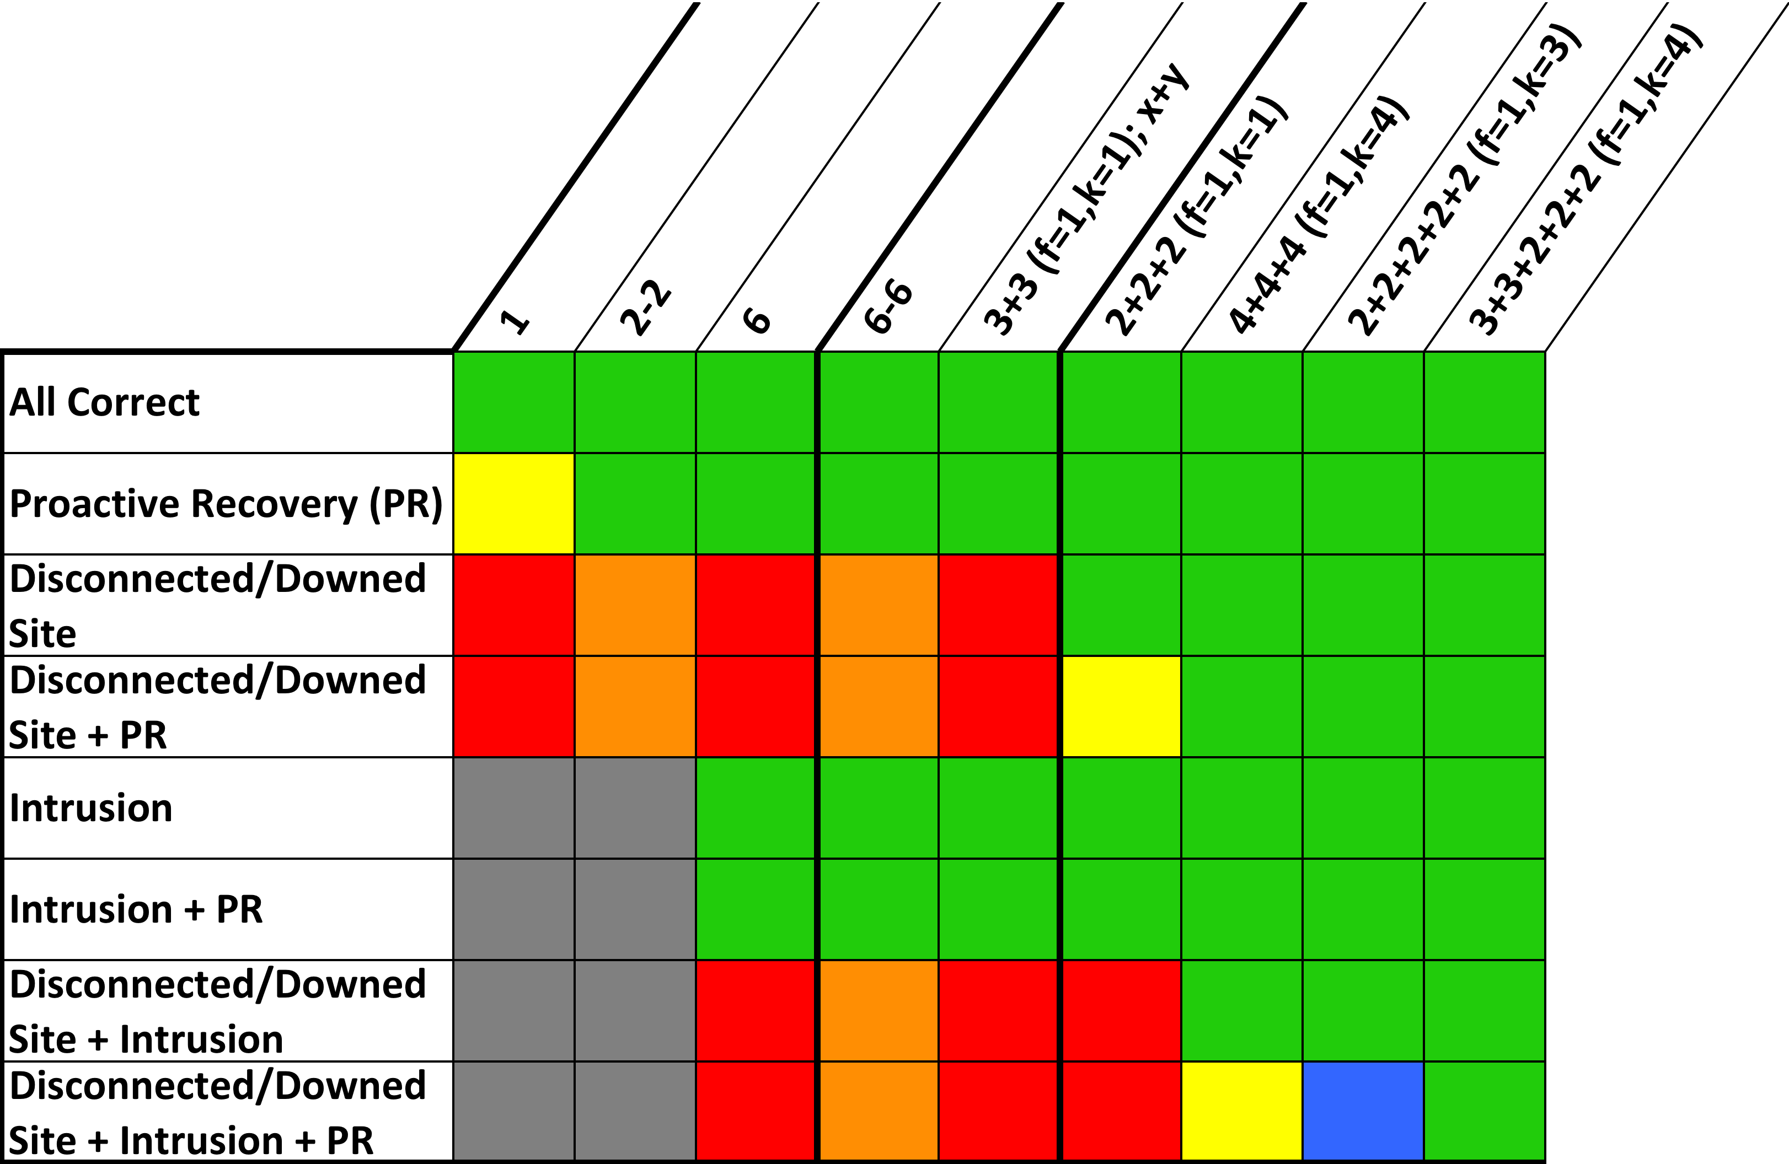
Novel Resilient Configurations (4/6)
3+3+2+2+2
(progress: 7)
Data Center 1
Data Center 2
Data Center 3
SM
SM
SM
SM
SM
SM
At least f+2 replicas in each control center ensures one correct replica that can control RTUs even with intrusion and ongoing rejuvenation in connected control site
Control Center 1
Spines
Control Center 2
HMI
SM
SM
SM
SM
SM
SM
HMI
Spines
First complete solution
RTU
PLC
…
Physical
Equipment
Physical
Equipment
Substation
Substation

Slide 28
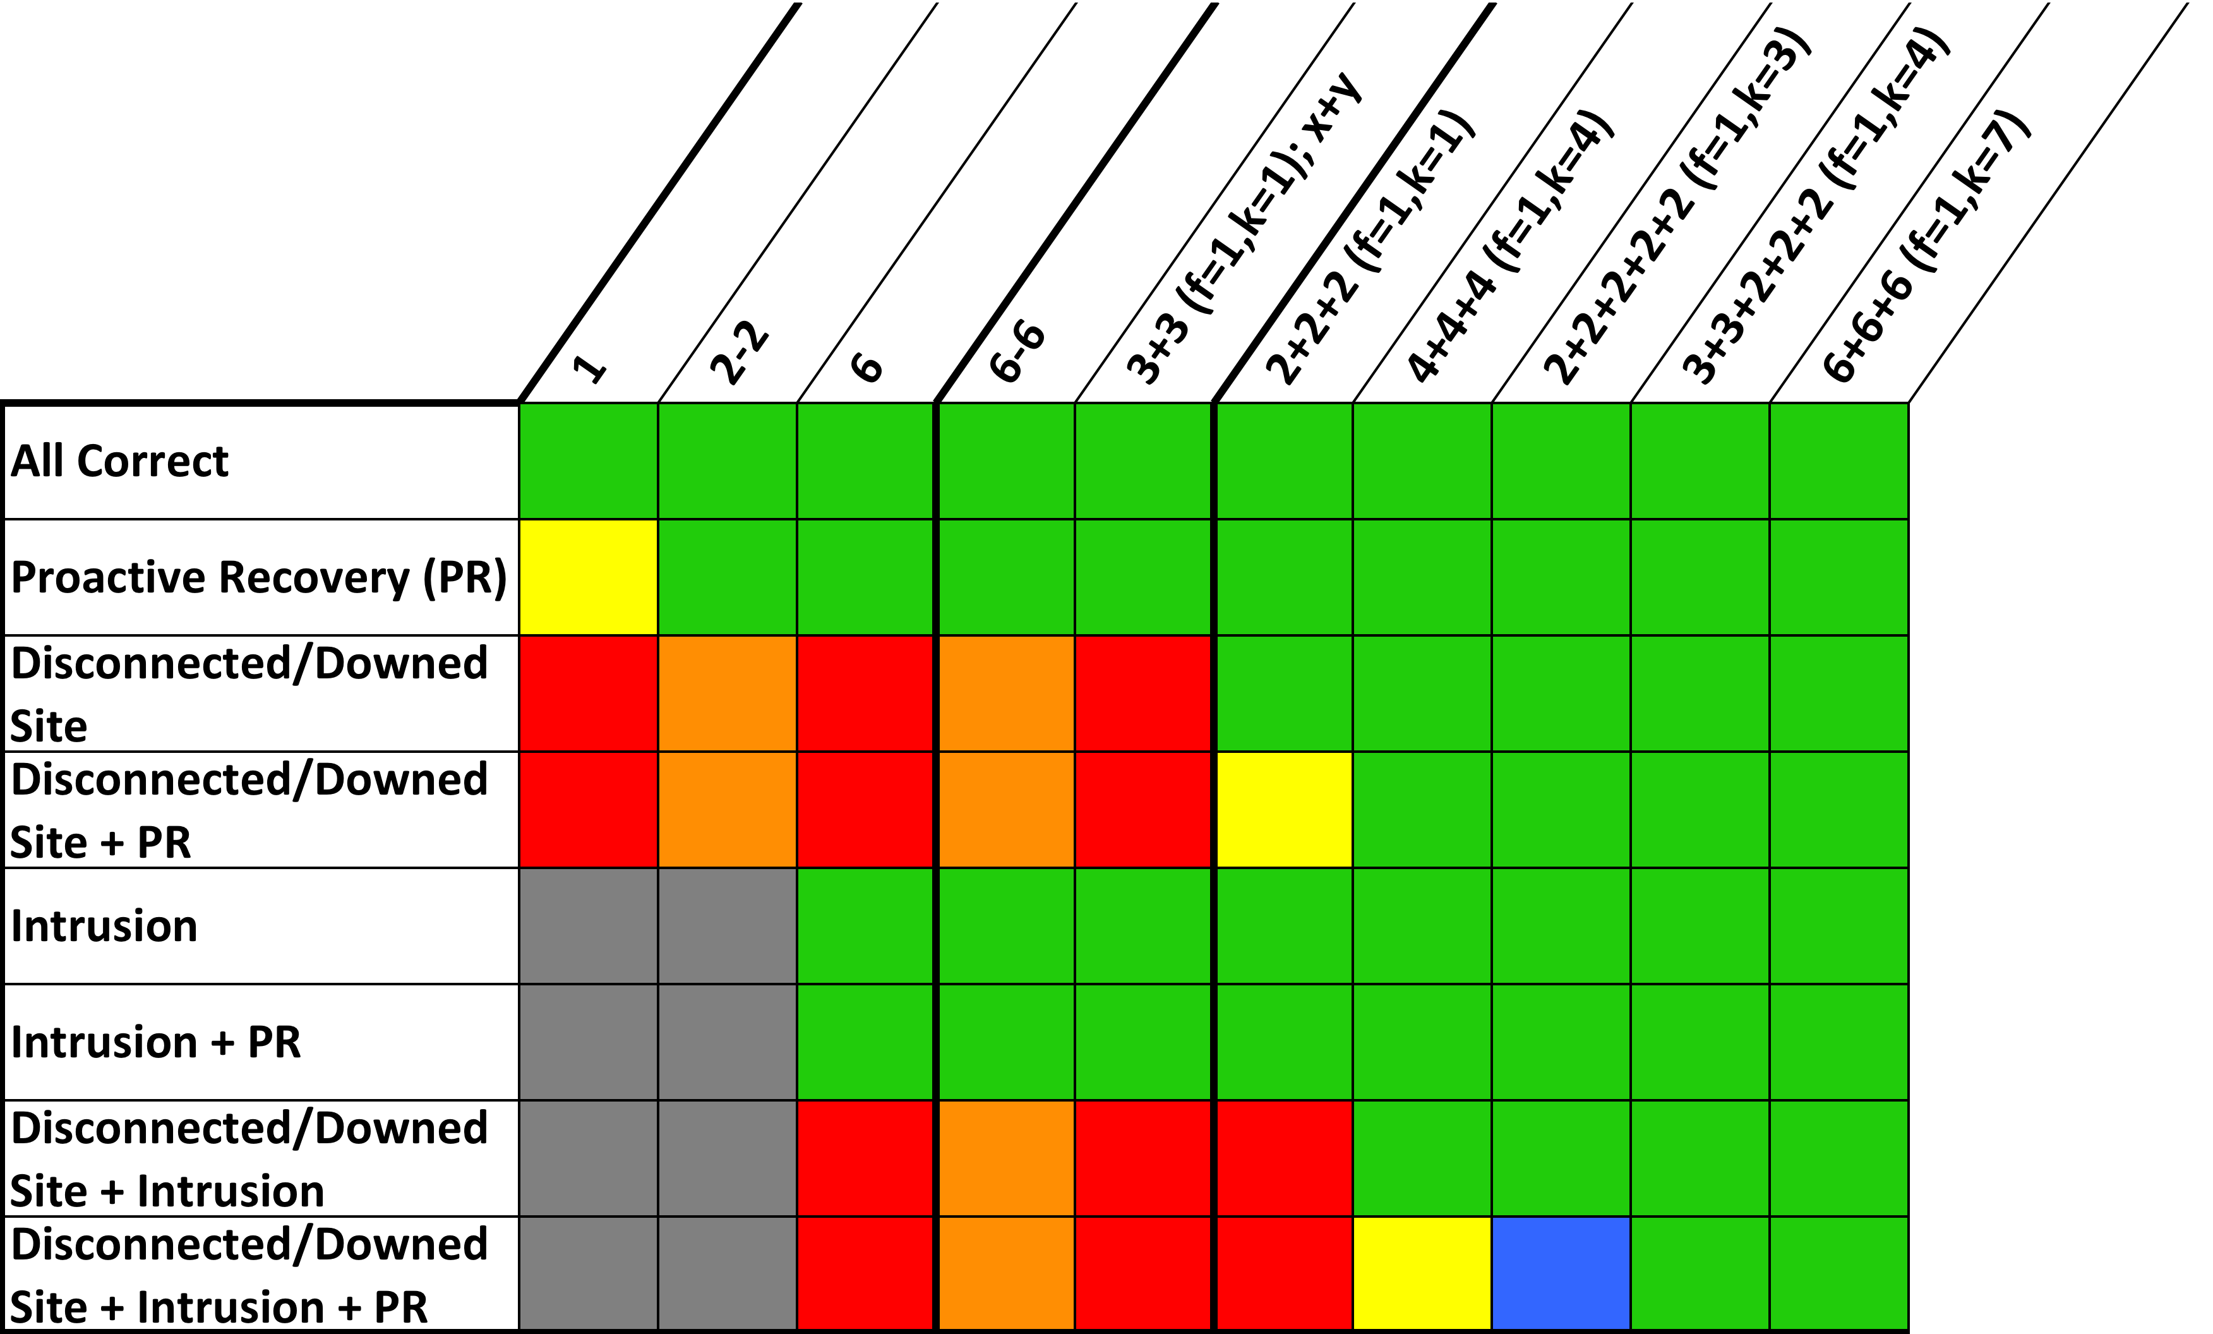
Novel Resilient Configurations (5/6)
6+6+6
(progress: 10)
Data Center 1
SM
SM
SM
SM
SM
SM
Complete solution for 3 total sites: (2 control centers, 1 data center)
Control Center 1
Spines
Control Center 2
HMI
SM
SM
SM
SM
SM
SM
SM
SM
SM
SM
SM
SM
HMI
Spines
RTU
PLC
…
Physical
Equipment
Physical
Equipment
Substation
Substation

Slide 29
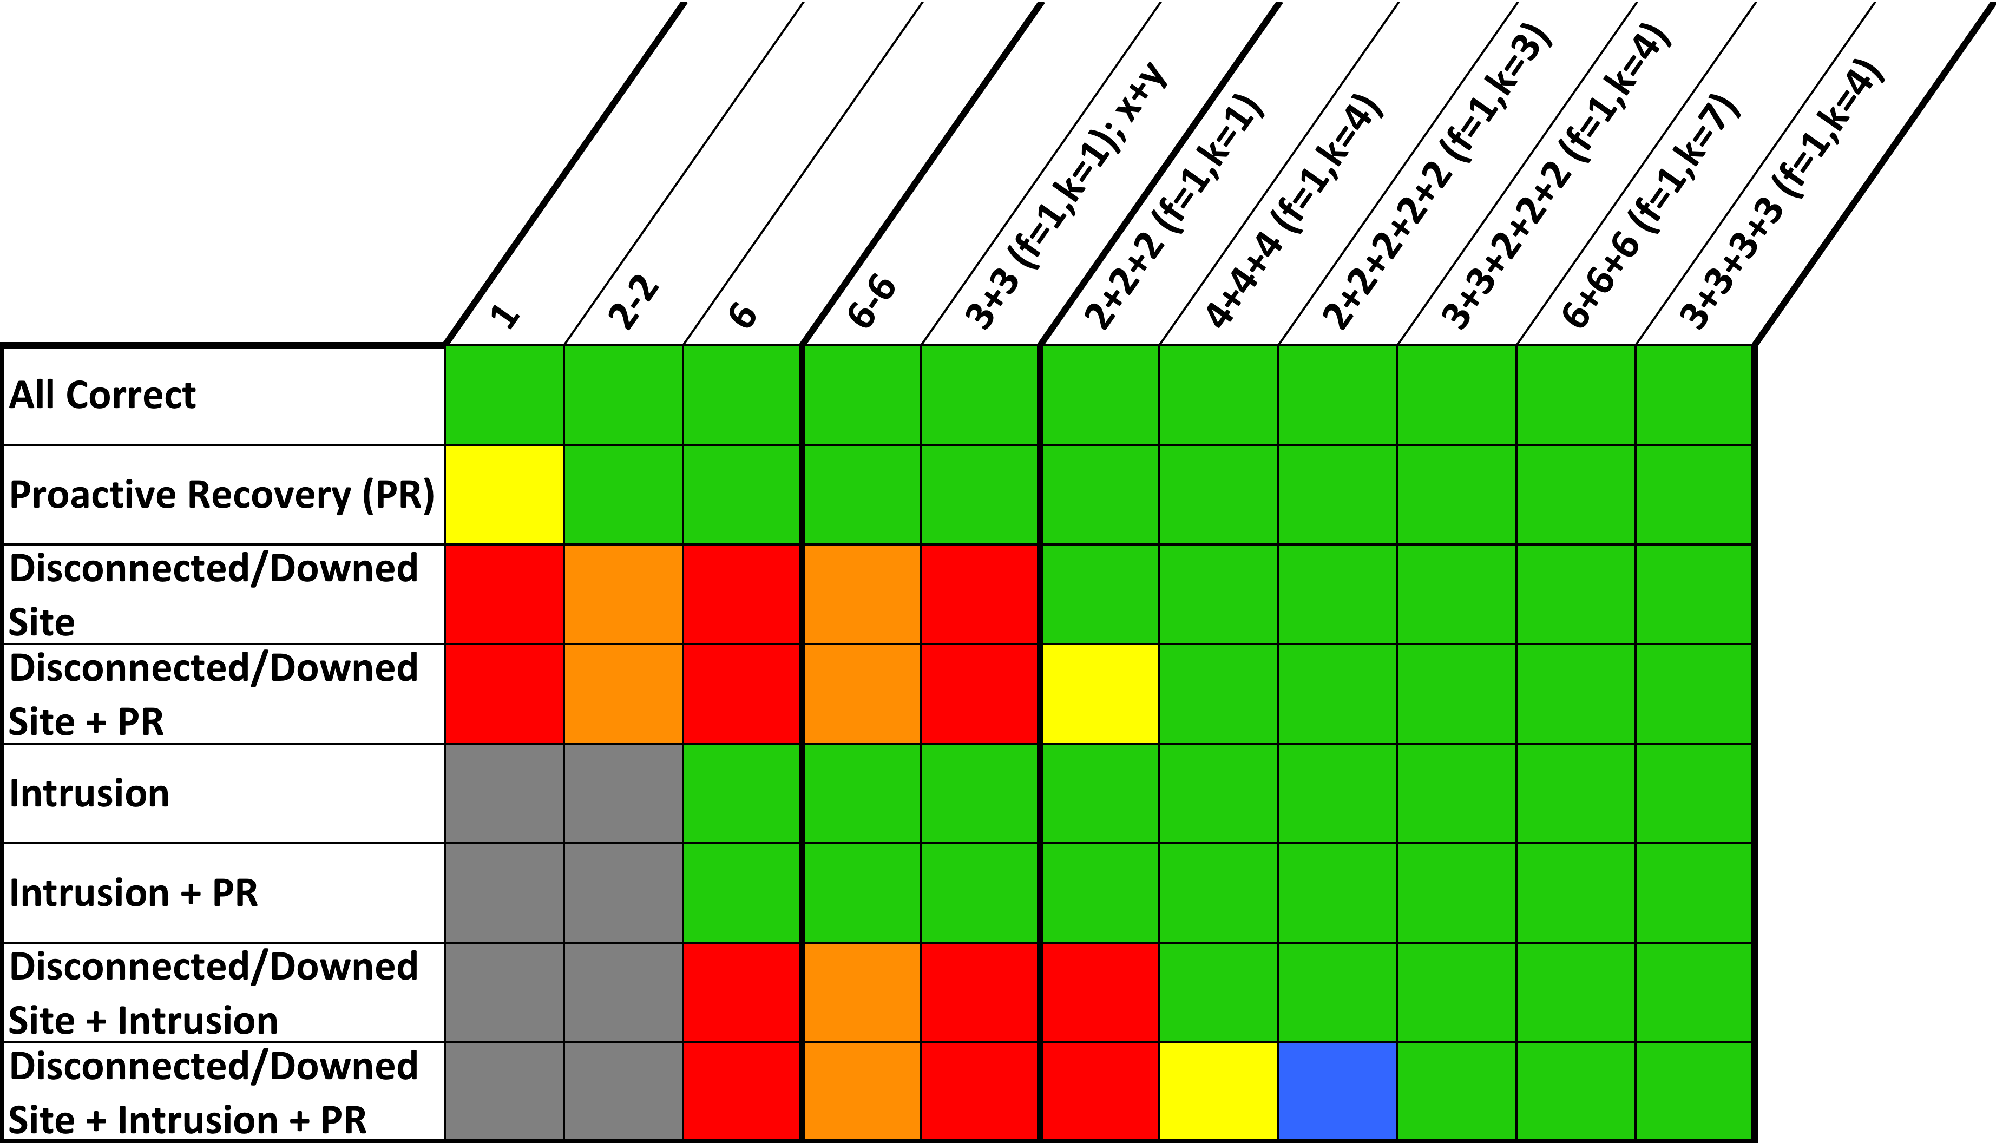
Novel Resilient Configurations (6/6)
3+3+3+3
(progress: 7)
Data Center 1
Data Center 2
SM
SM
SM
SM
SM
SM
Complete solution for 4 total sites: (2 control centers, 2 data centers)
Sweet-spot balancing the number of data center sites, the number of total replicas, and the communication overhead
Control Center 1
Spines
Control Center 2
HMI
SM
SM
SM
SM
SM
SM
HMI
Spines
RTU
PLC
…
Physical
Equipment
Physical
Equipment
Substation
Substation

Slide 30
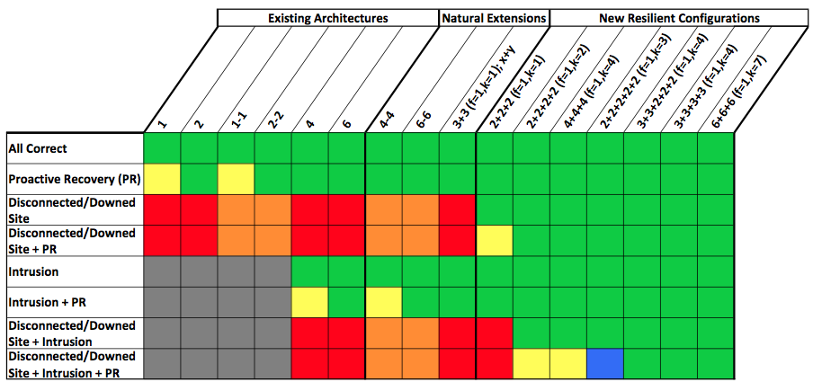
SCADA Architecture Comparison

Slide 31
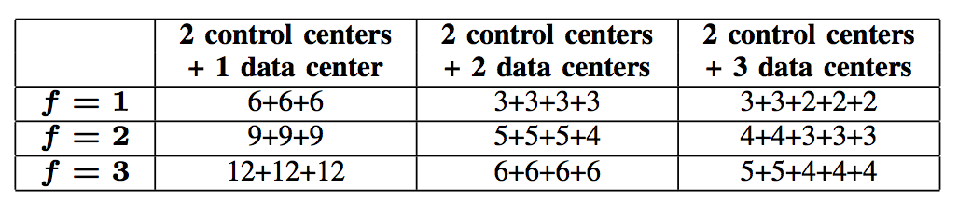
Intrusion-Tolerant SCADA Configuration Framework
General framework to create SCADA configurations that use S total sites (S > 2) and tolerate f intrusions
Minimum number of replicas required to overcome f intrusions, a single rejuvenating replica, and a single disconnected site, varying f and S (total number of sites).

Slide 32
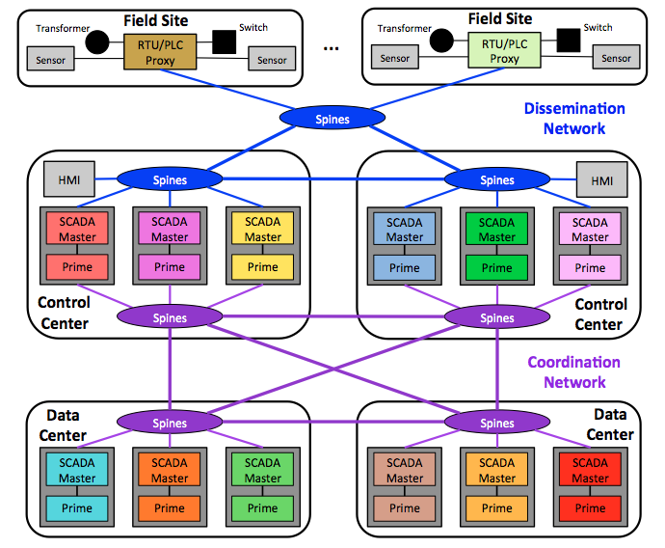
Putting it all Together: Complete SCADA System
Spire Software Architecture for Configuration 3+3+3+3

Slide 33
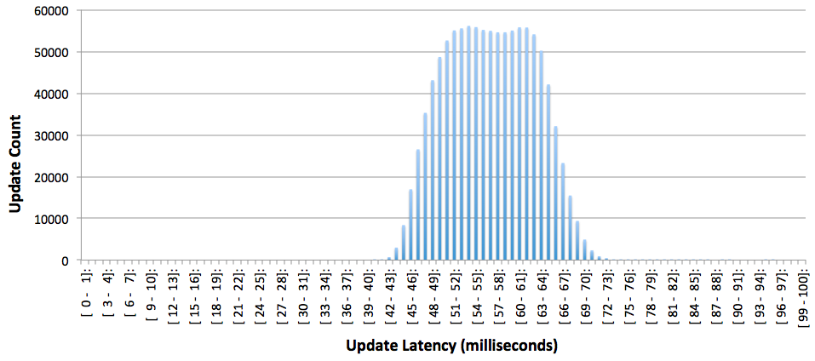
Wide Area Update Latency Histogram
30-hour wide-area deployment of configuration 3+3+3+3
Control centers at JHU and SVG, data centers at WAS and NYC
10 emulated substations sending periodic updates
1.08 million updates (108K from each substation)
Nearly 99.999% of updates delivered within 100ms (56.5ms average)

Slide 34
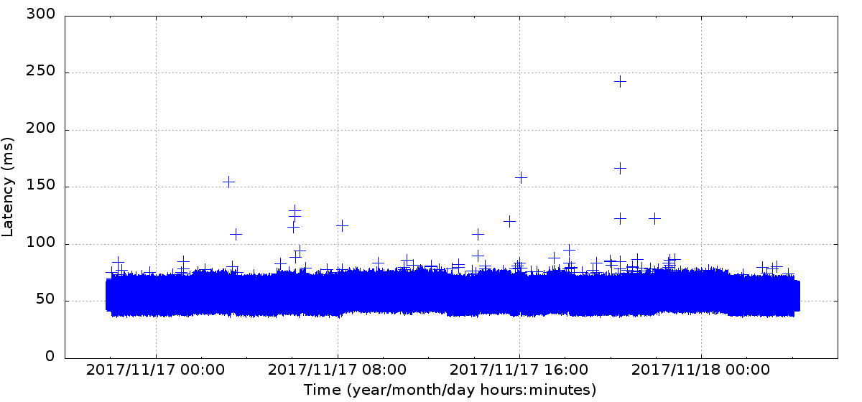
Wide Area Update Latency Plot
30-hour wide-area deployment of configuration 3+3+3+3
Only 13 updates out of 1.08 million delivered with latency exceeding 100ms
Only 1 update exceeded 200ms

Slide 35
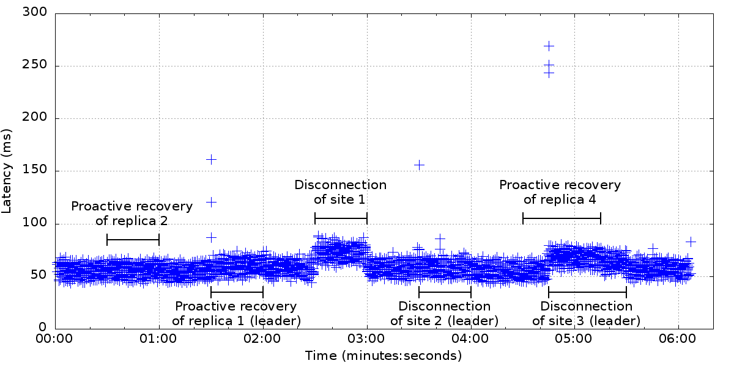
Wide Area: Latency Under Attack
Targeted attacks designed to disrupt the system
All combinations of site disconnection (due to network attack) + proactive recovery

Slide 36
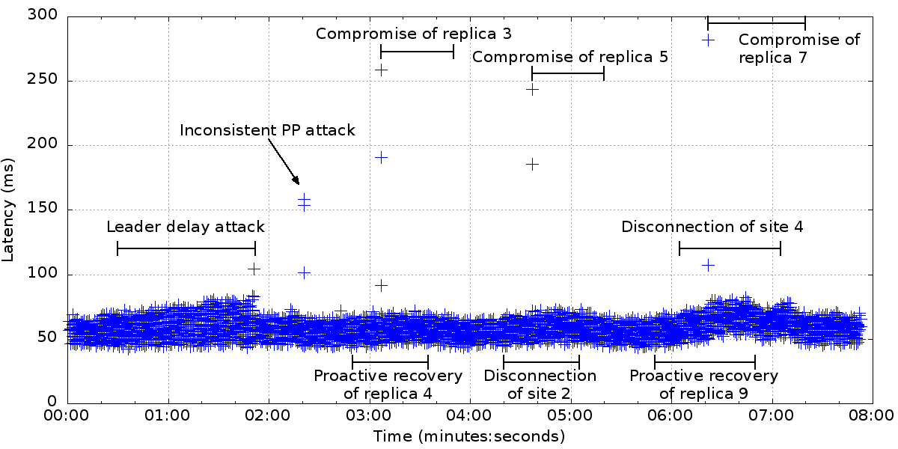
Wide Area: Latency Under Attack
Targeted attacks designed to disrupt the system
All combinations of intrusion + site disconnection (due to network attack) + proactive recovery

Slide 37


The Spire Forum
Forum focused on open source intrusion-tolerant control systems for the power grid
Please join the Spire forum if interested
http://dsn.jhu.edu/spire
Distributed Systems and Networks Lab

